Slide 1
IT Professional Environment: Law, Ethics and Privacy
Lecture and Tutorial Week 4:
Dr. Farshid Keivanian

Slide 2
Open-Ended Question
Why is it crucial for organizations to prioritize privacy, data protection, and security in today's digital age, especially with the rapid advancement of technology?
In today's digital world, privacy and data protection are more important than ever. With the increase in cyber threats, data breaches, and the amount of personal information shared online, organizations must prioritize these aspects to protect their customers and themselves. For example, a company like Telstra ensures that its data protection policies are up-to-date to safeguard customer communication privacy and avoid potential legal and reputational damage. Without such measures, companies risk losing customer trust and facing significant penalties.

Slide 3
Interactive Class Activity
How different organizations (in Australia or globally) have managed privacy and data protection and what the consequences were in cases where they failed?
Practical Example: Australian National University (ANU) Data Breach
Background: In November 2018, the Australian National University (ANU) experienced a significant data breach where attackers gained unauthorized access to 19 years' worth of sensitive personal information. This breach included information such as names, addresses, dates of birth, and academic records.
How ANU Managed Privacy and Data Protection Post-Breach:
Immediate Response: ANU immediately conducted a comprehensive investigation into the breach, working with cybersecurity experts to understand how the attackers gained access and what data was compromised.

Slide 4
Interactive Class Activity
How different organizations (in Australia or globally) have managed privacy and data protection and what the consequences were in cases where they failed?
2. Communication: ANU promptly informed the affected individuals, including students, staff, and alumni, about the breach and the potential risks associated with it.
3. Improved Security Measures: Post-breach, ANU implemented stronger cybersecurity measures, including enhanced monitoring of their IT systems, increased encryption of sensitive data, and more robust access controls to prevent unauthorized access in the future.
3. Public Accountability: ANU was transparent about the breach, publicly disclosing details of the incident and the steps they were taking to mitigate the damage and prevent future breaches.

Slide 5
Interactive Class Activity
Lessons Learned:
Importance of Proactive Security Measures: The ANU breach highlighted the need for organizations to be proactive in their approach to cybersecurity, rather than reacting after an incident occurs.
Transparency and Communication: ANU's transparent communication following the breach helped mitigate some of the reputational damage, showing the importance of being open with stakeholders in the aftermath of a security incident.
Ongoing Vigilance: The incident emphasized the need for ongoing vigilance and regular updates to security protocols, as threats are constantly evolving.

Slide 6
Safeguarding Personal Data and Privacy
Practical Scenario: Scenario: Imagine you're working for Telstra in Australia. The company needs to implement new policies to protect customer communication privacy better. How would you approach this task?
Class Discussion: Discuss another company that has implemented effective privacy and data protection measures.
Apple Inc. is an example of a company that has implemented effective privacy and data protection measures. Apple prioritizes user privacy through features like end-to-end encryption in iMessage and FaceTime, strict app store guidelines that prevent unauthorized data access, and transparency reports that inform users about government data requests. These measures have helped Apple maintain a strong reputation for protecting customer data.

Slide 7
Safeguarding Personal Data and Privacy
Multiple Choice Question: What is the primary focus of data protection?
A) Protecting customer service
B) Protecting individuals' personal data
C) Increasing sales
D) Improving network speed

Slide 8
Safeguarding Personal Data and Privacy
Open-ended Question: How can an organization ensure that it protects both the physical privacy and communication privacy of its employees?
An organization can protect both the physical privacy and communication privacy of its employees by implementing secure access controls for physical spaces, using surveillance responsibly, encrypting all digital communications, and ensuring that personal data is only accessed by authorized personnel. Regular privacy audits and employee training on data protection also help maintain a secure and private work environment.
Follow-Up Question: What are some potential consequences of failing to protect these types of privacy?

Slide 9
Safeguarding Personal Data and Privacy
Privacy and data protection involve safeguarding individuals' personal information and communication privacy. This can include protecting data from unauthorized access, ensuring secure communication channels, and protecting against physical intrusions or surveillance.
Practical Example: A company like Telstra in Australia may implement strict data protection policies to protect its customers' communication privacy and ensure that customer data is not accessed by unauthorized personnel.
Discussion Prompt: Discuss another example of a company that has implemented strong privacy and data protection measures.

Slide 10
Understanding the Australian Privacy Principles (APPs)
Practical Scenario: Scenario: Commonwealth Bank is revising its policies to ensure full compliance with APPs. How might they ensure transparency in handling customer data?
Class Discussion: Research another organization in Australia and discuss how it adheres to a specific APP.

Slide 11
Understanding the Australian Privacy Principles (APPs)
Multiple Choice Question: Which of the following is NOT part of the Australian Privacy Principles (APPs)?
A) Transparency
B) Anonymity
C) Data hoarding
D) Cross-border disclosure

Slide 12
Understanding the Australian Privacy Principles (APPs)
Explanation: The Australian Privacy Principles (APPs) provide guidelines for how personal information should be collected, managed, and disclosed. Adherence to these principles is crucial for maintaining customer trust and legal compliance.
Practical Example: Commonwealth Bank in Australia ensures that it follows APPs by providing transparency in how they handle customer data and offering options for anonymity and pseudonymity to their customers.
Discussion Prompt: Research another organization in Australia and discuss how it adheres to a specific Australian Privacy Principle.

Slide 13
Understanding the Australian Privacy Principles (APPs)
Open-ended Question: Why is it important for organizations to adhere to the Australian Privacy Principles (APPs), and how might failing to do so impact customer trust?
Follow-Up Question: Which APP do you think is the most challenging for organizations to comply with, and why?

Slide 14
Ethical and Legal Considerations in Data Disclosure
Practical Scenario: Scenario: Qantas Airways is required to disclose passenger data to a government authority. What steps should they take to ensure compliance with privacy laws?
Class Discussion: Design a scenario where data disclosure is necessary and discuss the ethical implications.

Slide 15
Ethical and Legal Considerations in Data Disclosure
Multiple Choice Question: Data disclosure should always be:
A) Done without customer consent
B) Transparent and legally compliant
C) Delayed as much as possible
D) Handled by unauthorized personnel

Slide 16
Ethical and Legal Considerations in Data Disclosure
Explanation: Data disclosure involves sharing personal information with third parties, often under legal obligations or business requirements. Organizations must ensure they do this transparently and with the customer’s consent, where necessary.
Practical Example: Qantas Airways may need to disclose passenger data to government authorities for security purposes. They must ensure this is done in compliance with privacy laws and regulations.

Slide 17
Ethical and Legal Considerations in Data Disclosure
Open-ended Question: In what situations might an organization be required to disclose customer data, and how can they ensure this is done ethically and legally?
Follow-Up Question: How does data disclosure impact customer relationships, especially in sensitive situations?

Slide 18
Implementing Effective Access Control Systems
Practical Scenario: Scenario: The Australian Taxation Office (ATO) needs to implement a role-based access control system. How would this protect taxpayer information?
Class Discussion: Find another example of an organization that uses access control effectively and discuss how it benefits the organization.

Slide 19
Implementing Effective Access Control Systems
Multiple Choice Question: What is the primary goal of access control?
A) Allowing unrestricted access to all data
B) Managing who has permission to view or use resources
C) Disclosing sensitive information
D) Increasing the number of users

Slide 20
Implementing Effective Access Control Systems
Explanation: Access control involves managing who has permission to view or use resources within an organization. Effective access control systems are crucial for protecting sensitive information from unauthorized access.
Practical Example: The Australian Taxation Office (ATO) uses role-based access control to ensure that only authorized personnel can access sensitive taxpayer information.
Discussion Prompt: Find another example of an organization that uses access control effectively and discuss how it benefits the organization.

Slide 21
Implementing Effective Access Control Systems
Open-ended Question: How can an organization implement effective access control mechanisms to protect sensitive data?
Follow-Up Question: What challenges might an organization face when trying to enforce strict access controls, and how can they overcome them?

Slide 22
The Role of Digital Certificates in Secure Communications
Practical Scenario: Scenario: Westpac is upgrading its online banking security. How does the use of digital certificates ensure the protection of customers' financial data?
Class Discussion: Research and present another example of how a digital certificate is used in a real-world application.

Slide 23
The Role of Digital Certificates in Secure Communications
Multiple Choice Question: A digital certificate is primarily used to:
A) Increase transaction speed
B) Prove ownership of a public key
C) Generate random passwords
D) Encrypt emails

Slide 24
The Role of Digital Certificates in Secure Communications
Explanation: A digital certificate is an electronic document used to prove the ownership of a public key. It helps ensure that communications are secure and that the parties involved are who they claim to be.
Practical Example: Westpac in Australia uses digital certificates to secure online banking transactions, ensuring that customers’ financial data is protected during transmission.
Discussion Prompt: Research and present another example of how a digital certificate is used in a real-world application.

Slide 25
The Role of Digital Certificates in Secure Communications
Open-ended Question: Why are digital certificates important for ensuring secure communication in online transactions?
Follow-Up Question: What might happen if an organization fails to use digital certificates properly?

Slide 26
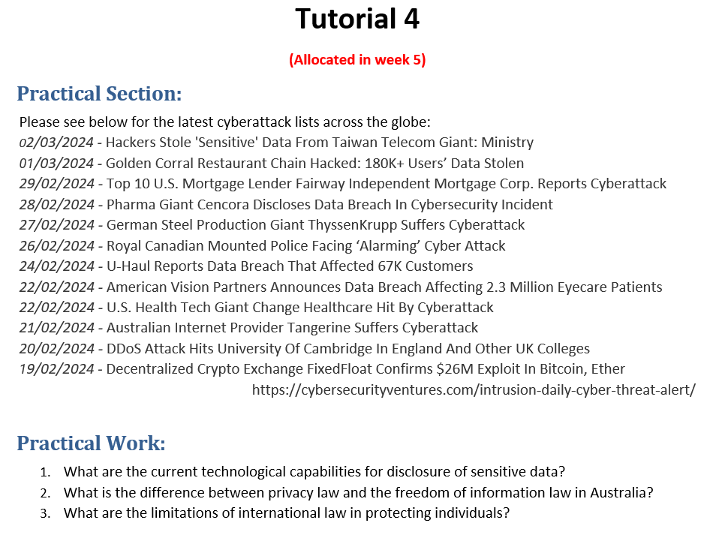

Slide 27
1. Current Technological Capabilities for Disclosure of Sensitive Data
Answer: Current technological capabilities for the disclosure of sensitive data focus on both protecting and controlling access to data. These include:
Encryption: Ensures that data, even if intercepted, remains unreadable without the correct decryption key.
Data Masking: Obscures data elements within a dataset so that even if unauthorized users access the dataset, the sensitive information is concealed.
Access Control Mechanisms: Utilizes role-based access control (RBAC) to restrict who can view or edit certain data, ensuring only authorized personnel have access.
Intrusion Detection Systems (IDS): Monitor network traffic for suspicious activity and can alert administrators to potential breaches, helping to prevent unauthorized data disclosure.
Data Loss Prevention (DLP) Solutions: Prevents the unauthorized transfer of sensitive data outside the organization’s network.
Blockchain Technology: Offers a decentralized way of recording transactions securely, making it difficult for unauthorized alterations or disclosures.

Slide 28
Practical Example: In the case of the Australian Internet Provider Tangerine, after suffering a cyberattack, the organization could implement advanced encryption and DLP solutions to prevent further unauthorized disclosures of sensitive customer information.

Slide 29
2. Difference Between Privacy Law and Freedom of Information Law in Australia
Answer:
Privacy Law: In Australia, privacy law is primarily governed by the Privacy Act 1988, which protects individuals' personal information from being collected, used, or disclosed without their consent. It mandates how personal information should be handled by organizations, including the collection, storage, and sharing of data.
Freedom of Information (FOI) Law: The Freedom of Information Act 1982 gives the public the right to access government-held information. It is designed to promote transparency and accountability in government by allowing individuals to request documents and information from government bodies.

Slide 30
Key Difference: While privacy law focuses on protecting individual privacy and personal data from unauthorized access or disclosure, the FOI law is about granting public access to government information, which can sometimes involve the release of documents that contain personal data. The challenge is balancing these rights to privacy with the public's right to information.
Practical Example: A healthcare organization in Sydney must navigate both privacy and FOI laws when responding to requests for patient records. They must ensure that they do not disclose personal health information without proper consent while fulfilling the transparency requirements under FOI laws.

Slide 31
3. Limitations of International Law in Protecting Individuals
Answer: International law faces several limitations when it comes to protecting individuals, particularly in the context of privacy and data security:
Jurisdictional Challenges: Different countries have varying laws regarding data protection, making it difficult to enforce uniform standards across borders. What is legal in one country may be illegal in another, complicating international cooperation.
Enforcement Mechanisms: International law often lacks strong enforcement mechanisms. Organizations or individuals may not face significant penalties if they breach international agreements unless these are supported by strong domestic enforcement.
Lack of a Global Framework: There is no single, unified global framework governing data protection and privacy, leading to inconsistencies in how individuals' rights are protected across different countries.
Data Sovereignty Issues: Countries may assert control over data within their borders, leading to conflicts when data needs to be shared or protected across borders.

Slide 32
Practical Example: A tech company based in Brisbane operating internationally must be aware of these limitations. For example, when handling data transfers between Australia and the European Union, the company must comply with the GDPR in the EU while also adhering to Australian privacy laws, navigating the complexities of differing regulations.

Slide 33
Class Activities:
For Technological Capabilities:
Activity: Please research and present on different data protection technologies currently used by companies. You could compare the effectiveness of these technologies in preventing data breaches.
For Privacy vs. FOI Laws:
Activity: Please one group argues from the perspective of privacy law, and the other argues from the perspective of FOI law. Debate on a scenario where releasing information might breach individual privacy.
For International Law:
Activity: Please choose different countries and discuss how international agreements on data protection are implemented (or not) in your chosen country. You can present the challenges companies face in complying with multiple legal systems.

